Slide 1


Exprime tus proyectos SPFX
Ruben Toribio | Luis Mañez
6th of November 2021
@SUG_Cat @CollabDays #CollabdaysBCN
Notes:
Template may be modified but please keep the title and the sponsor slide.
Twitter hashtag: #CollabdaysBCN for all sessions

Slide 2

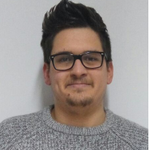
Ruben Toribio
Sharepoint & M365 Architect and Full Stack Developer
Hiberus
@Rtoribiog
6 of November 2021

Slide 3

Luis Mañez
Chief Architect
ClearPeople
@luismanez
6 of November 2021

Slide 4









Gold
Online
Organized by
Notes:
Use this as the first slide in your slide deck

Slide 5
Agenda (TBC)
Welcome
Spfx WSL2
Managing multiple spfx solutions
Spfx Fast serve
Bundle improvements
Performance improvements
Modernize your spfx projects

Slide 6
SPFx
WSL2

Slide 7
01.
Install Windows Terminal
02.
Install WSL2
Install it from Windows Store
https://docs.microsoft.com/en-us/windows/wsl/install
03.
Beautiful prompt
04.
Install Node Version Manager
https://www.hanselman.com/blog/how-to-make-a-pretty-prompt-in-windows-terminal-with-powerline-nerd-fonts-cascadia-code-wsl-and-ohmyposh
https://github.com/nvm-sh/nvm
05.
Install NodeJS using NVM
06.
Setup SPFx
nvm install 14.18.1
nvm use 14.18.1
sudo apt-get install build-essential
npm install -g yo gulp
npm install -g @microsoft/generator-sharepoint@next
07.
SPFx certificate
08.
Git Setup
New SPFx Project
Npm install
Gulp trust-dev-cert
Import manually the certificate found: $home/.rushstack
git config --global user.name "John Doe"
git config --global user.email {your_github_email}
git config --global core.filemode false
git config --global core.autocrlf true
https://www.m365-dev.com/2020/05/29/setup-wsl2-for-spfx-development/

Slide 8
Gotchas installing WSL2
No network connection
echo "[network]" | sudo tee /etc/wsl.conf
echo "generateResolvConf = false" | sudo tee -a /etc/wsl.conf
sudo rm -Rf /etc/resolv.conf
echo "nameserver 8.8.8.8" | sudo tee /etc/resolv.conf
sudo chattr +i /etc/resolv.conf
Sharing SSH Keys between Windows and Linux
https://devblogs.microsoft.com/commandline/sharing-ssh-keys-between-windows-and-wsl-2/
Yeoman too slow
Ensure you are using latest versión
Yeoman cannot find generators
Run: yo doctor
You might need to re install YO generators after upgrading

Slide 9



Empty SPFx Project | Windows | Ubuntu (WSL2)
Npm install | 1 min 57 secs | 1 min 34 secs
Gulp bundle --ship | 15 secs | 11 secs
Gulp package-solution --ship | 4.38 secs | 2.4 secs
Delete node_modules folder |  | Na y menos

Slide 10

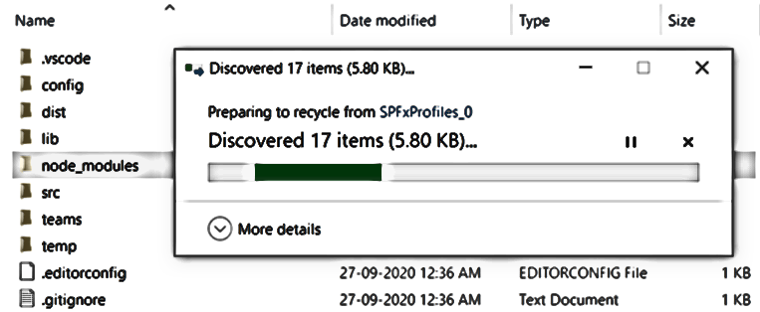

Slide 11
Managing multiple SPFx solutions

Slide 12
Contoso intranet SPFx solution
contoso-intranet
webparts
my-groups
cool-weather
my-expenses
stories
todays-lunch
extensions
related-content
translate-page
libraries
contoso-ui-components
graph-groups-services

Slide 13

Lerna
$ npm install –-global lerna
$ lerna init
$ lerna bootstrap
$ lerna run build
$ lerna run –parallel serve
https://spblog.net/post/2019/06/24/using-lerna-to-manage-spfx-projects-with-library-components

Slide 14

Lerna demo

Slide 15
Modernize your spfx projects
No more IE11 support!!
https://www.voitanos.io/blog/optimize-spfx-bundles-ditch-ie11-support/
ESLint over TSLint
https://www.voitanos.io/blog/spfx-replace-tslint-with-eslint-preset/

Slide 16
No more IE11 demo

Slide 17
https://github.com/luismanez/collabdays-bcn-2021

Slide 18
Resources
https://www.m365-dev.com/2020/05/29/setup-wsl2-for-spfx-development/
https://devblogs.microsoft.com/commandline/sharing-ssh-keys-between-windows-and-wsl-2/
Using Lerna to manage SPFx projects with library components (spblog.net)

Slide 19
Thank you!
Questions?
#CollabdaysBCN

